Slide 1

Security Controls in
Shared
Code Repositories
Jackie Scott Module 11 9/30/24

Slide 2
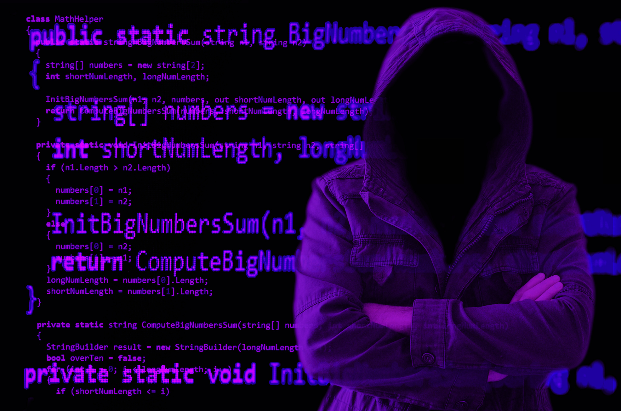
Source Code Repositories
A source code repository is a centralized storage space for code and other software development resources. These repositories can hold things such as documentation, tests, and scripts. They are commonly used to organize or manage a project’s codebase and facilitate collaboration among teams.
Repositories can be hosted in three ways:
Locally on-premise
On a network-attached storage NAS device
Remotely on a cloud service.

Slide 3


Source Code Security
Why is it Important?
Integrity in the Software Supply Chain
When source code is secure, it helps ensure that every component, even third-party libraries in the internal code, remains unaltered and trustworthy. This is critical for building and having a reliable application. Security measures can help organizations avoid potential disruptions in their development processes.
Protection against malicious attacks
Source code security helps prevent a breach, which can result in significant financial loss and damages to the organization’s reputation, and sometimes legal consequences are prevented. Securing a code repository by monitoring can help detect suspicious activities quickly.
Protects privacy and the organization
Source code repositories often contain proprietary algorithms and business logic. If compromised, this information could be exploited. Furthermore, safeguarding can help build trust with clients and stakeholders.

Slide 4

Source Code Security
How to enhance the security of your source code
Complying with best practices is essential for improving the overall security of your source code. Protecting source code from any potential threats and vulnerabilities. Some effective strategies to consider are
Secure Identities and Access
Code Commit Integrity
Secrets Management
Tools for Source Code Security

Slide 5



Securing Identities and Access
By focusing on the following access control measures, organizations can manage user identities to ensure that only authorized people have access to sensitive source code and repositories.
Authentication
Role-Based Access Control
Review and Update Permissions
Implementing a multi-factor authentication, MFA, adds an extra security layer. MFA requires users to provide two or more verification factors. This makes it harder for unauthorized people to gain access to a repository.
Using the RBAC principles of least privilege helps ensure that only individuals with authorization can interact with source code.
Conducting regular audits of all user permissions helps ensure all accounts are appropriate to their role and team. This helps identify and revoke unnecessary access, reduces potential attacks, and helps the overall security posture.

Slide 6



Code Commit Integrity
Having a focus on code-commit integrity can help organizations protect their source code from any unauthorized changes. It reinforces the overall security of the software development lifecycle.
Enforce Code Signing for Commits
Use Cryptographic Signatures
Implementing a code signing policy that requires all commits to be signed by whoever is making changes helps verify the identity of the developer and ensures there is no code tampering.
This method involves generating a unique hash of the code changes that are then encrypted with the developer’s private key. This creates a strong defense against potential malicious code injections.

Slide 7
Secrets Management
By prioritizing effective secret management practices, organizations can protect critical information and reduce the likelihood of data breaches.
Store Sensitive Date Securely
Use Secrets Management Tools
Keep sensitive information such as API keys, passwords, and access tokens separate from the source code. This mitigates the risk of exposure if a breach were to occur.
Implement tools designed to store, manage, and retrieve sensitive information. These tools offer features like encryption, access control, and audit logs.

Slide 8




Tools for Source Code Security
Implementing tools and solutions to help with source code security can help organizations have a robust security framework for their source code. The four specialized tools can help reduce the risk of vulnerabilities in repositories.
Static Application Security Testing Tools
Container Security Solutions
SAST tools analyze source code for vulnerabilities without executing a program. Tools like Checkmarx or Fortify can identify code flaws early.
These tools focus on securing containerized applications through their lifecycle. Aqua Security or Twistlock offer features for compliance checks and runtime protection for container images.
Software Composition Analysis Tools
Web Application Firewalls
SCA tools help manage and identify vulnerabilities in open-source components and their dependencies. WhiteSource or OWASP Dependecny-Check can the codebase and third-party libraries are secure and up to date.
WAFs protect web applications by filtering and monitoring HTTP traffic between a web application and the Internet. AWS WAF or Imprerva safeguards against common web exploits such as SQL injections.

Slide 9

Works Cited
Scantist. (2024, July 22). 18 github security best practices to follow L Scantist. 18 GitHub Security Best Practices to Follow l Scantist. https://www.scantist.com/resources/blogs/18-github-security-best-practices-for-a-secured-repository
Securing source code in repositories is essential: How to get started. Snyk. (2023, November 16). https://snyk.io/learn/securing-source-code-repositories/
Vermeer, B. (2024, February 5). 10 github security best practices. Snyk. https://snyk.io/blog/ten-git-hub-security-best-practices/
What is a source code repository. Sonatype. (n.d.). https://www.sonatype.com/resources/articles/what-are-code-repositories

Slide 10

Thank You

